Slide 1
How to write a CV in easy 7 steps
WRITING
UNIT 9

Slide 2
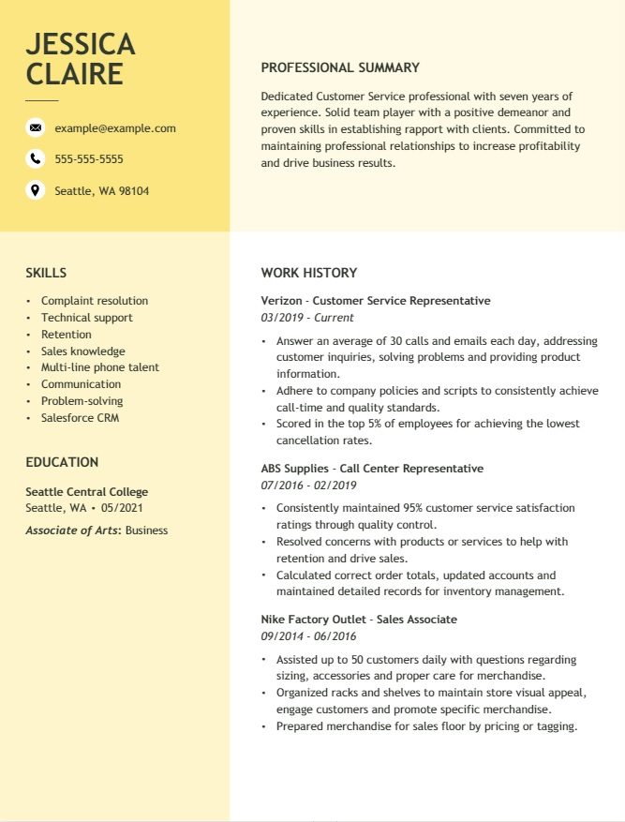
SEVEN STEPS
Choose a CV template.
Add your contact information.
Write your CV’s summary statement.
List your relevant work experience.
Craft your CV Education section.
Add relevant skills for the role.
Include additional CV sections.

Slide 3
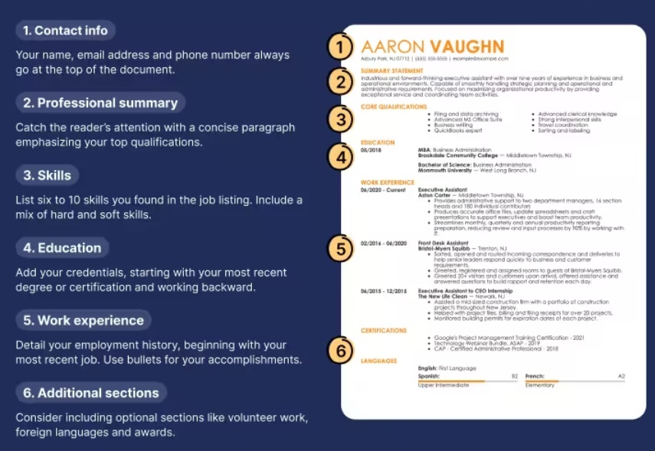
THE 6 BASICS cv SECTIONS
TRY TO FOLLOW THIS STRUCTURE

Slide 4
TIPS & SUPPORT
TIPS | AVOID
Present it in a clear and organized way Don’t make it too long. One page would be perfect! Use formal and not complicated language Spell-check your CV (Proofread, proofread, proofread!) Be truthful! Customize your CV for every job Be as specific as possible. | Writing a generic CV Focusing on job duties rather than achievements Including irrelevant information Failing to focus on the employer’s needs Using an unprofessional email address. Slang and jargon, contractions, abbreviations (IMO)
HOW TO WRITE A CV: https://www.resume-now.com/job-resources/cv/how-to
WORK SKILLS: https://www.youtube.com/watch?v=Olov9iu8YLw

